Slide 1
Final Project
Erik Johnson

Slide 2
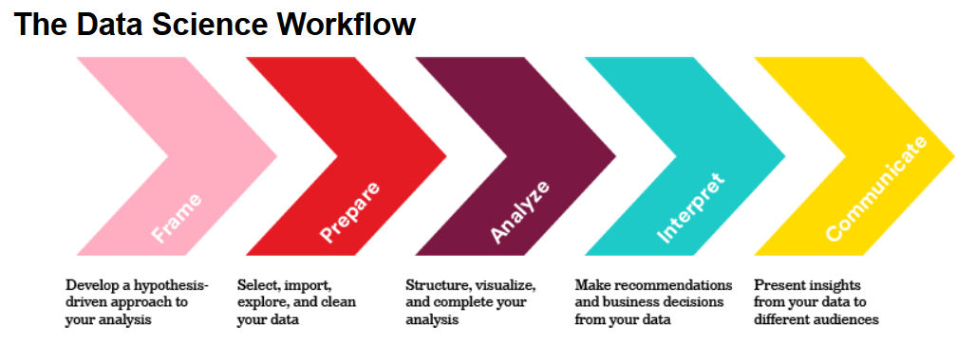

Slide 3

Business objectives / Success criteria
Determine if any attributes of sales leads are predictive of converting to a sale
Research question
What are the drivers of conversion to sale?

Slide 4

Dataset
Merged dataset of sales leads with broader industry dataset
Outcome variable
Conversion (measured as “converted” or “purchased”)

Slide 5
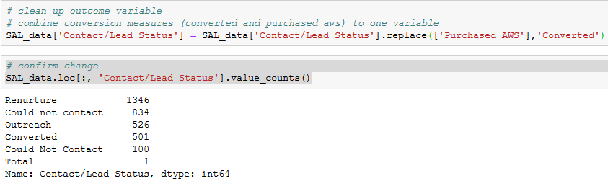

Outcome variable
Conversion

Slide 6
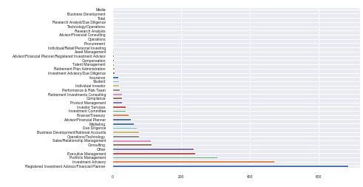
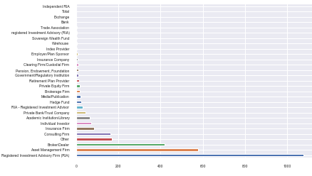
Potential predictors
Role type: 37 different role types listed
- Top 5: RIA, Investment Advisory, Portfolio Management, Executive Management, Other
Firm type: 29 different firm types
-Top 3: RIA, Asset Manager, Broker/Dealer

Slide 7
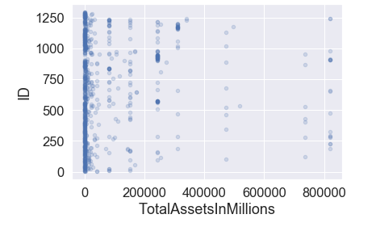
Potential predictors
Total Assets

Slide 8
Analysis
Build a model to determine if total assets predicts conversion
Analysis Technique
Logistic regression

Slide 9
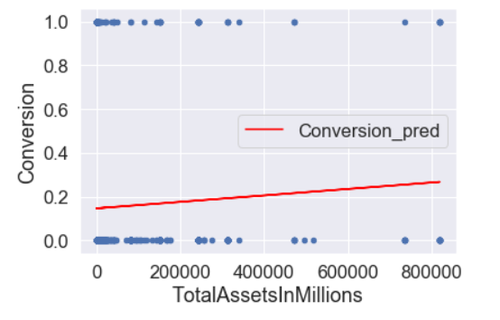
0.8493150684931506
Results
SciKit Learn classification model score:
0.8493150684931506

Slide 10
Findings
Average account size can be a predictor of conversion
Recommendations
Develop clearer segments of firm and role types for a cleaner analysis
Find or develop a cleaner dataset. Appears to be noisy.
Explore other attributes such as investment strategy
Look past basic attributes and to behaviors for better predictors
Do a clustering analysis of the many variables in the dataset

